Slide 1
Compliance of Aspiration Tubing and Cassettes of 6 Phacoemulsification Machines
Mitra Nejad, BS,¹ and Kevin Miller, MD^{1,2}
¹ David Geffen School of Medicine at UCLA, Los Angeles, CA
²Jules Stein Eye Institute and Department of Ophthalmology, David Geffen School of Medicine at UCLA, Los Angeles, CA
The authors have no financial interest in the subject matter of this poster

Slide 2
Abstract:
Purpose: To compare the compliance of the aspiration tubing in six different phacoemulsification machines.
Methods: The capacitance and tubing compliance of the INFINITI Vision System (Alcon Laboratories, Fort Worth, Texas), with Intrepid and Standard cassettes, the WhiteStar Signature phacoemulsification system (Abbott Medical Optics, Santa Ana, California) and the Stellaris Vision Enhancement System (Bausch & Lomb, Rochester, New York), were measured. Also tested were older models from same three manufacturers. After each system was primed using Balanced Salt Solution (BSS), the aspiration line was connected to an electronic pressure transducer and digital oscilloscope. Small volumes of fluid were injected and aspirated from the aspiration line to generate pressure-volume curves for each consumable pack.
Results: Under controlled laboratory settings, the INFINITI system with Intrepid tubing demonstrated the lowest compliance while the Legacy proved to be the most compliant. The AMO and Bausch and Lomb systems exhibited very similar pressure-volume curves.
Conclusions: The lower compliance of the INFINITI Intrepid system should lessen the hazards associated with occlusion break surge, thus enhancing clinical performance and safety.

Slide 3
Background
The fluidic subsystems of the phacoemuslfiers used in cataract surgery account for a large portion of their performance and safety profiles.
A system’s compliance is a measure of its ability to expand or contract in response to applied fluidic pressure.
Compliance, which is the inverse of stiffness, is defined as ∆volume/∆pressure.
In phacoemulsification systems, aspiration line compliance is a function of the mechanical properties of the aspiration tubing and the cassette that mates with the pump mechanism.

Slide 4
Background
When the tip of a phacoemulsification or irrigation–aspiration probe becomes occluded, the pump stops turning once the system senses that vacuum limit has been reached.
Variable amounts of potential energy are stored in the walls of the tubing and cassette depending on the compliance of these components and the vacuum limit set by the surgeon.
Vacuum is useful for holding onto and aspirating solid lens fragments, but occlusion break can cause problems when it happens under high vacuum.
At occlusion break, the potential energy stored in the tubing and cassette suddenly releases, causing a sudden suctioning of fluid from the eye to fill the recoiled volume.
The anterior chamber collapses in response to the sudden loss of volume, risking damage to the cornea, iris, or lens capsule.
Occlusion break surge might possibly be eliminated if phacoemulsification systems could be designed that had zero compliance.

Slide 5
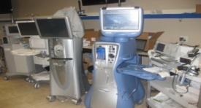
Background
In a previous experiment, we demonstrated a measurable difference in occlusion surge between the 3 leading manufacturer's newest phacoemulsification systems. At equivalent vacuum limits, the primary determinant of surge amplitude is the system compliance.
As a next logical step in our studies, we decided to measure the compliance of the new and old phacoemulsifiers from Alcon, AMO and Bausch & Lomb.
Systems Studied:
Bausch and Lomb:
Stellaris Vision Enhancement system
Millennium Micorsurgical system
Alcon Laboratories Inc:
INFINITI Vision system (both Intrepid
and Standard tubing)
Advantec Legacy
Abbot Medical Optics:
WhiteStar Signiture
Whitestar Sovereign

Slide 6
Methods
Before measuring compliance, cassettes (phaco packs) were loaded into each of the 6 phacoemulsifiers and the devices were primed with balanced salt solution, taking care to eliminate all air bubbles.
An electronic pressure transducer was connected to a power supply and a digital storage oscilloscope. The irrigation line, aspiration line, and a 1ml U-1100 latex free insulin syringe were connected to the transducer. The pressure transducer was placed at the same height as the vacuum sensor in the cassette of the machine under test.
To generate compliance curves for positive and negative fluid displacements, balanced salt solution was injected and withdrawn from the aspiration line in small increments. Measurements were obtained by injecting 0.05 mL, recording the pressure, then withdrawing 9 increments of 0.05 mL (a net withdrawal of 0.40 mL), recording the line pressure at each point. The process was also reversed to test for hysteresis.

Slide 7
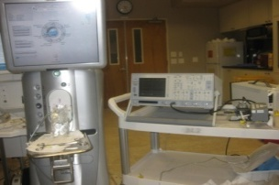
Methods
Compliance curves were generated for 3 cassettes per phacoemulsifier and averaged. In addition, 1 cassette per instrument was tested 3 times to look for fatigue, which is a change in compliance with repeated testing. All testing was done on the same day to minimize variability due to atmospheric and temperature conditions.
Additionally, the capacitance of one cassette from each system was measured. The volume held in the aspiration tubing until the very edge of the cassette was recorded as well as the volume needed to fill half of the pump tubing in the cassette and the volume needed to obtain one drop of fluid in the bag.

Slide 8
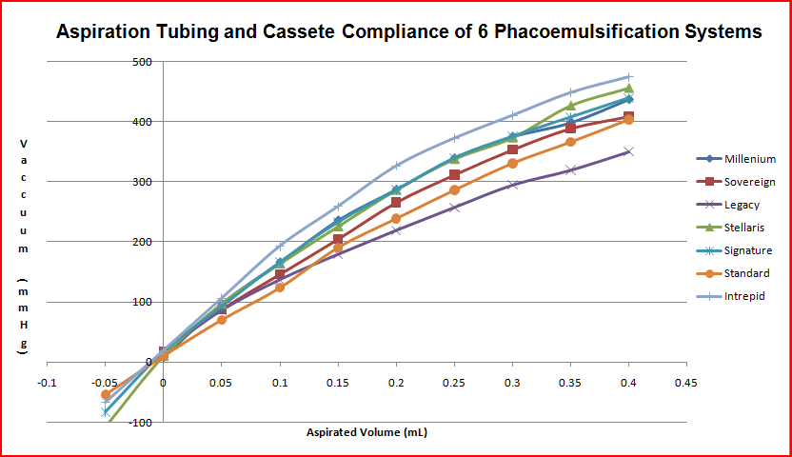
Results
Figure 1: Compliance curve for all six systems, in addition to the Infiniti standard tubing. A steeper slope indicates a lower compliance.

Slide 9
Results
The 7 cassettes that were tested demonstrated similar compliance curves under negative and positive pressure loading. Compliance curves for all systems were reproducible between three different cassettes and between three trials on one cassette. The Infiniti Intrepid tubing demonstrated the least compliance (steepest curve) for both the average of three cassettes and three runs on one cassette. The Legacy Advantec proved the most compliant for both sets of data.
The Infiniti Intrepid tubing showed significantly lower compliance than its predecessor, the Legacy Advantec. Both, the Signature and the Stellaris systems had less pronounced compliance difference as compared to the previous generation units, the Sovereign and the Millenium, respectively.

Slide 10
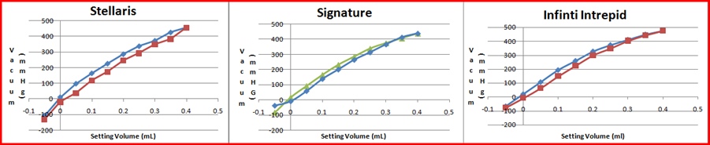
Results
All six systems demonstrated a hysteresis when compliance curves obtained by aspirating fluid and compliance curves obtained by injecting fluid were compared. The curves for the newer models are shown above.

Slide 11
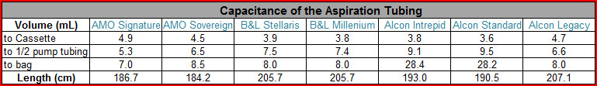
Results
The Alcon Infiniti standard and Infiniti Intrepid packs had three to four times the fluid capacity of the other systems when comparing the capacitance from the tip of the aspiration line to the bag because of an extra fluid chamber held in the cassette. Since this chamber is filled after fluid has passed the pump, this volume should not contribute to the compliance of the tubing.
Comparing the capacitance of the tubing half way through the pump reveals that the Infiniti Intrepid and Infiniti standard packs have a capacitance of 9.1 and 9.5 ml, respectively, compared to 5.3 mL for the Signature and 7.5 mL for the Stellaris .

Slide 12
Conclusions
The phacoemulsification system that has the lowest occlusion break surge allows for the most effective and safest procedure.
Since occlusion break surge is largely determined by the tubing’s compliance, the same can be said for the system which is the least compliant.
Our results illustrate improvements in the fluidics of the newer phacoemulsification systems by all three major manufacturers.
Our study demonstrates that the Infiniti Intrepid tubing is the least compliant and therefore should provide the best clinical performance.

