Slide 1
Prospective, Randomized Comparison of Fellow Eyes Undergoing SBK with Use of Brimonidine 0.025%, Naphazoline 0.025% with Pheniramine 0.3%, or Artificial Tears
Daniel S. Durrie M.D.
Joel D. Hunter M.D.
Durrie Vision
Overland Park, KS

Slide 2
Dr. Durrie Potential Conflicts of Interest
Presently Dr. Durrie is a clinical investigator for:
Alcon
Allergan
AMO
Bausch and Lomb
IntraLase
Refractec
Acufocus
WaveTec
Avedro
Encore Vision
LenSx
Dr. Hunter has no financial relationships to disclose.
Wavefront Science
NeuroVision
High Performance Optics
OcuSense
QuestVision
Visiometrics
Tracey Technologies
High Performance Optics
Topcon
Ocular Optics

Slide 3
Purpose
To compare injection, subconjunctival hemorrhage, patient comfort, and adverse events during and after SBK for each of the three drops.

Slide 4
Background
Brimonidine is a selective α-2 adrenergic agonist that causes vasoconstriction when administered topically^{1,2}
Recently shown to increase chance of flap slip after LASIK,³ and to decrease chance of flap slip after LASIK⁴
Naphazoline is a non-selective adrenergic agonist with greater α-1 than α-2 effect⁵
Only study in literature addressing naphazoline with LASIK did not address complications⁶

Slide 5
Study Design
This 1-hour and 1-day prospective, randomized clinical trial includes 180 consecutive patients (360 eyes) that underwent Sub-Bowman Keratomileusis (SBK) for the correction of myopia or hyperopia with or without astigmatism
All procedures were performed with the IntraLase FS Laser and Wavelight Allegretto

Slide 6
Study Design
Patients were randomized into three groups receiving differing drops in each eye pre-operatively
Alphagan P 0.025% in one eye and Naphcon-A in the contralateral eye
Alphagan P 0.025% in one eye and Systane Ultra in the contralateral eye
Naphcon-A in one eye and Systane Ultra in the contralateral eye

Slide 7
Study Design
Patients filled out questionnaires one hour and one day post-operatively to compare pain and irritation for each eye
Patients were also examined one hour and one day post-operatively for uncorrected visual acuity, injection, subconjunctival hemorrhage, and debris under the flap

Slide 8
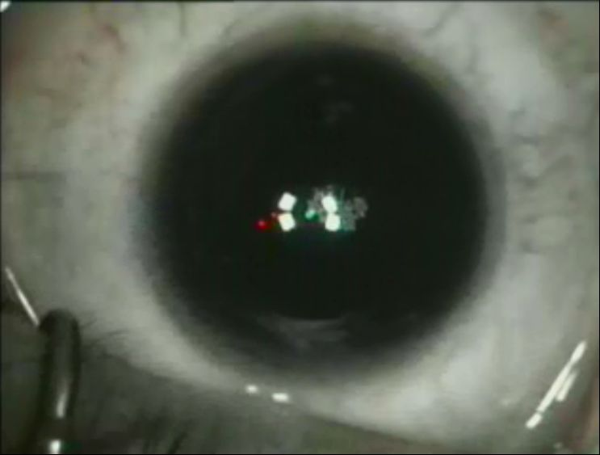
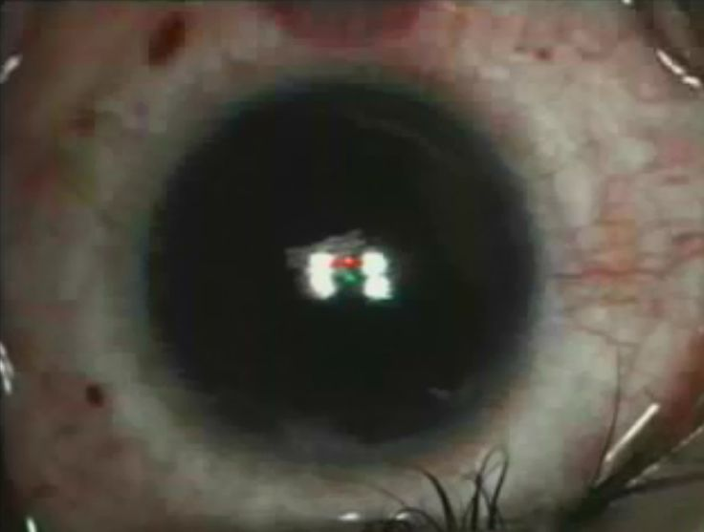
Alphagan 0.025% vs. Systane Ultra
Intra-operative photos of same patient with Alphagan 0.025% OD (R) and Systane Ultra OS (L)

Slide 9
Current Findings
100 of 180 patients enrolled, with expected completion of enrollment May 2010
Single incidence of bilateral flap slip in patient randomized to Naphcon vs. Brimonidine 0.025%

Slide 10
Reports to Come
To be presented at AAO 2010 with complete follow up on all 180 patients
One hour and one day patient questionnaires comparing preference between eyes
One hour, one day, one month, and three month comparisons of uncorrected and best corrected visual acuity, as well as manifest refraction vs. pre-operative target refraction

Slide 11
References
Nielsen H, Thom SM, Hughes AD, Martin GN, Mulvany MJ, Sever PS. Postjunctional alpha 2-adrenoceptors mediate vasoconstriction in human subcutaneous resistance vessels. Br J Pharmacol. 1989 Jul;97(3):829-34.
McGrath JC. Evidence for more than one type of post-junctional alpha-adrenoceptor. Biochem Pharmacol. 1982 Feb 15;31(4):467-84.
Nowroozzadeh MH. Early flap dislocation with perioperative brimonidine use in laser in situ keratomileusis. J Cataract Refract Surg. 2010 Feb; 36(2):368.
Rodríguez-Galietero A, Martínez JV, Del Buey A, Bescós JA. Use of brimonidine before LASIK with femtosecond laser-created flaps for the correction of myopia: a contralateral eye study. J Refract Surg. 2010 Jan;26(1):28-32
Ogidigben MJ, Chu TC, Potter DE. Naphazoline-induced suppression of aqueous humor pressure and flow: involvement of central and peripheral alpha(2)/I(1) receptors. Exp Eye Res. 2001 Mar;72(3):331-9.
Gu B, Dou X, Sima J, Peng N. The application of naphcon eye drops during Lasik surgery. Yan Ke Xue Bao. 2004 Dec;20(4):206-7.

