Slide 1
One and two-year clinical outcomes of LASIK for high hyperopia
Dan Z Reinstein MD MA(Cantab) FRCSC^{1,2,3,4}
Timothy J Archer, MA(Oxon), DipCompSci(Cantab)¹
Marine Gobbe, MSTOptom, PhD¹
1. London Vision Clinic, London, UK
2. St. Thomas’ Hospital - Kings College, London, UK
3. Weill Medical College of Cornell University, New York
4. Centre Hospitalier National d’Ophtalmologie, (Pr. Laroche), Paris, France
Financial Disclosure:
The author (DZ Reinstein) acknowledges a financial interest in Artemis™ VHF digital ultrasound (ArcScan Inc, Morrison, CO)
The author (DZ Reinstein) is a consultant for Carl Zeiss Meditec AG (Jena, Germany)

Slide 2
Methods - Patients
636 eyes
371 patients
Age: 18 to 78 years, median 51 years
BSCVA: 66% ≥ 20/20
Planned two-stage treatments = 20% (none enhanced)
Enhancement rate: 25%
  This includes patients who could see 20/20
  If enhancement had been denied for 20/25 or better,
  the enhancement rate would have been 9%
Hyperopia: +4.00 to +7.50 D, mean +5.35 ± 1.01 D
Cylinder : 0.00 to -3.00 D, mean -0.98 ± 0.70 D
Surgery: MEL80 excimer Laser, Hansatome microkeratome or Visumax femtosecond
Visual axis centration
Optical zone: 7 mm
Notes:
% 20/25

Slide 3
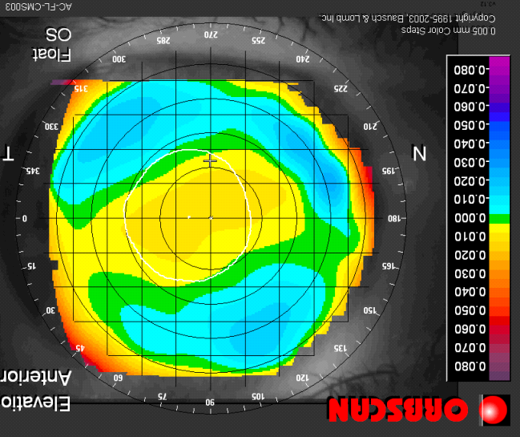
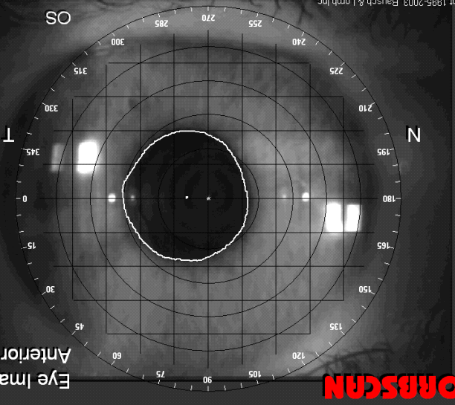
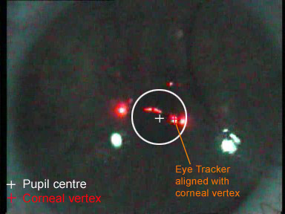
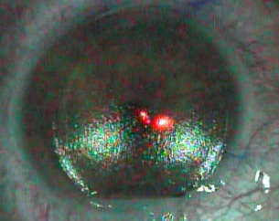
Methods: Corneal Vertex Centration
Example: Eye with a large nasal angle kappa
I
I
I
I
T
N
T
N
T
N
T
N
S
S
S
S
+ Pupil centre
+ Corneal Vertex
Pupil margins
Flap edge
Orbscan Anterior Elevation Map
Hansatome flap centred with corneal vertex
MEL80 Eye Tracker aligned with corneal vertex
Orbscan Eye Image
Flap and corneal ablation centred on the corneal vertex
Corneal vertex best approximates the visual axis
No difference in outcomes (accuracy, safety, contrast sensitivity) between a group of eyes with a small angle kappa (pupil centre ≈ corneal vertex) and group of eyes with a large angle kappa (pupil offset ≥ 0.55 mm) ^{[1]}
Corneal ablation should be centred on the corneal vertex (≈ visual axis) and not the pupil centre (line of sight)
[1] Reinstein et al – Centration of hyperopic ablations: corneal vertex vs pupil centre – AAO, Atlanta, 2008.

Slide 4
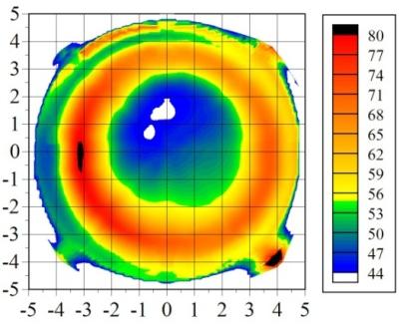
Methods: Artemis Two-stage treatment
  Artemis two-stage treatment for refractions over +5.50D
  Primary treatment: up to +5.50D in the maximum hyperopic meridian
  Post-operative Artemis
Measurement of thinnest epithelium
Calculation of treatable remaining hyperopia based on minimum epithelial thickness
Epithelial thickness is a more reliable tool than keratometry to determine the amount of ablation that can be performed ^{[1]}
Epithelial Thickness
Epithelial Thickness
Attempted SEQ
Max Sim K
Patient could have a flat cornea, but thin epithelium: not suitable for retreatment
Patient could have a steep cornea, but thick epithelium: suitable for retreatment
[1] Reinstein et al. Epithelial Thickness After Hyperopic LASIK: Three-dimensional Display With Artemis Very High-frequency Digital Ultrasound. J Refract Surg. 2009 Nov 24:1-10

Slide 5
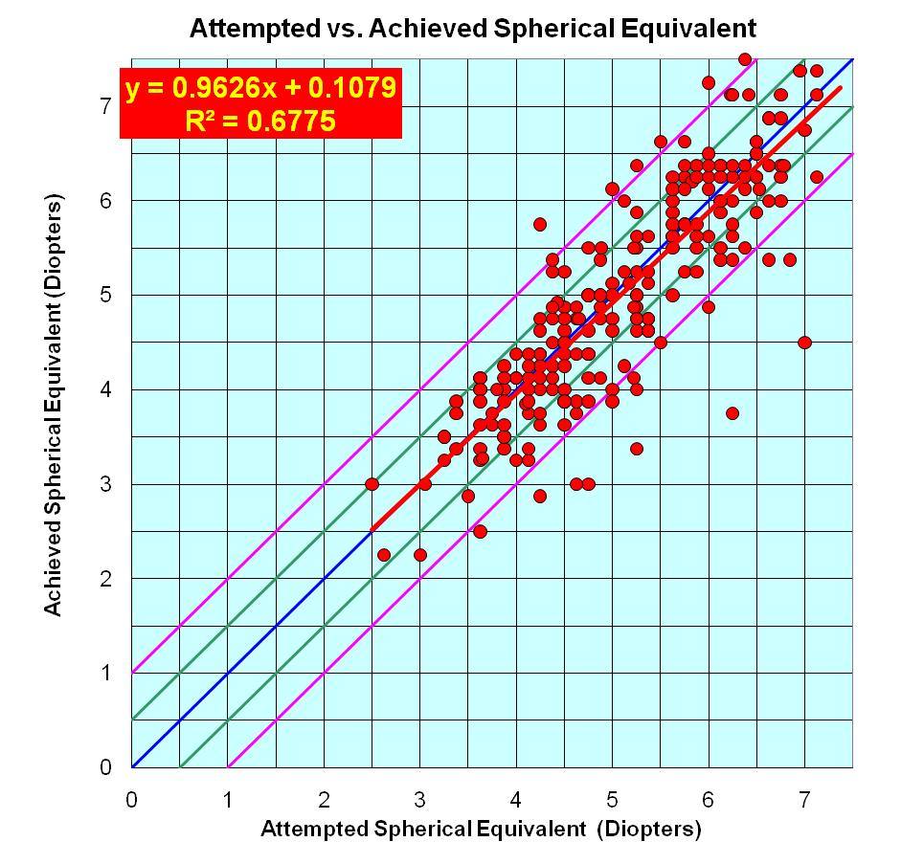
Results: Accuracy
Within ±0.50 D | 62%
Within ±1.00 D | 85%

Slide 6
Results: Efficacy
(excluding eyes not intended plano)
Monocular UDVA
n=237
mean max hyperopia +5.37 ± 1.00D
Pre-op, 70% of eyes had 20/20 best-spectacle corrected VA.
Post-op, 59% of eyes achieved 20/20 unaided.
Post UDVA vs Pre CDVA
83% within 1 line of Pre CDVA
  Post-op, 83% of eyes achieved unaided VA that was within 1 line of the pre-op spectacle corrected vision.
94% within 2 lines of Pre CDVA

Slide 7
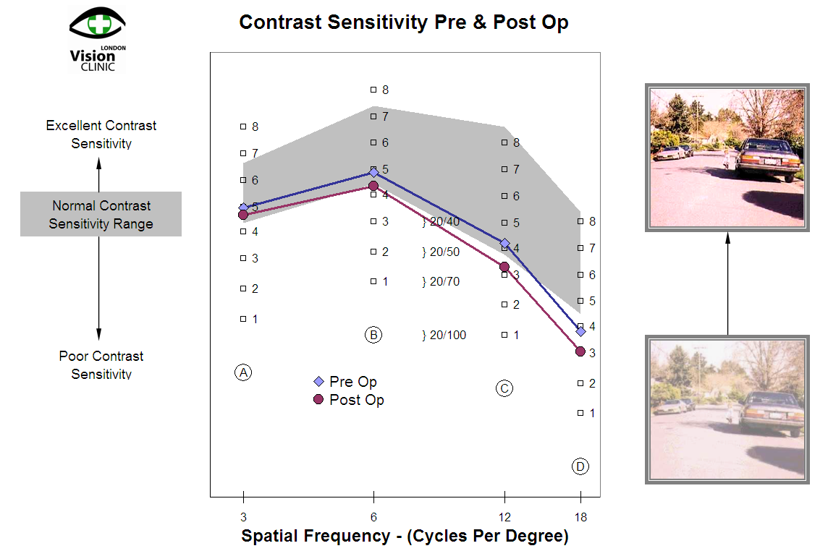
Results: Safety – BSCVA and Contrast Sensitivity
No eyes loss 2 lines or more
*
Slight statistically significant decrease in contrast sensitivity at all spatial frequencies
Average decrease: less than 1 patch
Little clinical significance
*
*
*
Notes:
Get rid of logo
Discuss clinical significance of contrast drop

Slide 8
Stability
3 Mo
6 Mo
12 Mo
24 Mo
 | Pre-op | 1 Day | 1 Month | 3 Months | 6 Months | 1 Year | 2 Years
Mean±SD | +4.19±1.38 | -0.31±0.62 | -0.10±0.75 | +0.04±0.75 | +0.16±0.78 | +0.36±0.85 | +0.52±0.94
# eyes | 636 | 517 | 561 | 594 | 514 | 405 | 201
If we assume that the refraction is stable at 3 months (post-operative oedema has resolved), the hyperopic shift at 2 years is 0.48 D (0.52 D at 2y – 0.04 D at 3m)
We know that the average hyperopic shift with age is 0.42 D in 5 years = 0.08 D/year ^{[1,2]}
The hyperopic shift due to LASIK regression is 0.32D at 2 years (0.48D – 0.08 D x 2)
[1] Guzowski et al. Five-year refractive changes in an older population: the Blue Mountains Eye Study. Ophthalmology. 2003 Jul;110(7):1364-70.
[2] Gudmundsdottir et al. Five-year refractive changes in an adult population: Reykjavik Eye Study. Ophthalmology. 2005 Apr;112(4):672-7.
Notes:
Comment on age drift to explain some of the regression

Slide 9
Outcomes Comparison: Accuracy, Safety, Efficacy of Phakic IOLs vs LASIK – High Hyperopia
 |  | Accuracy within |  | Loss 2 lines | Efficacy
 | Rx treated | ± 0.50D | ± 1.00 D |  | UCVA≥ 20/40
Artisan IOL FDA ^{[1]} | +4.00 to +12.00D | 65.5% | 98.2% | No data | 85.5%
Artisan phakic IOL ^{[2]} | +2.75 to +9.25 D | 50% | 78% | 0 | 89%
Posterior chamber phakic IOL ^{[3]} | +4.00 to +11.00D | 58% | 79% | 4% | 63%
RLE & multifocal IOL ^{[4]} | +1.75 to +6.00D | 88% | 100% | 0 | 100%
RLE Staar/Rayner IOL ^{[5]} | +4.75 to +13.00 D | 70% | 90% | 0 | 25%
Acrysoft RLE ^{[2]} | +2.75 to +7.50 D | 55% | 91% | 0 | 82%
LASIK – MEL80 | +4.00 to +7.00 D | 65% | 93% | 0% | 95%
[1] Desai et al - Long-term results of the Artisan IOL for the correction of severe and extreme hyperopia in the United States: A prospective Multi-Center Study – ARVO 2008.
[2] Pop M. Payette Y. Refractive lens exchange versus iris-claw Artisan Phakic Intraocular Lens for Hyperopia. J Refract Surg. 2004;20:20-24
[3] Davidorf et al – Posterior chamber phakic intraocular lens for hyperopia +4 to +11 diopters. J Refract Surg. 1998; 14(3): 306-311
[4] Dick et al – Refractive lens exchange with an array mutifocal IOL – J Refract Surg. 2002;18:509-518
[5] Preetha et al – Clear lens extraction with intraocular lens implantation for hyperopia. J Cataract Refract Surg. 2003;29: 895-899

Slide 10
Conclusion
Equal or better outcomes than IOLs
Risks associated with IOLs avoided:
  No endothelial cell loss (4.3% over 3 years with Artisan IOL ^{[1]}, 5.4% over 1 year with Kelman Duet Phakic IOL ^{[2]})
  No PCO (7.1% to 31.1% with monofocal IOLs ^{[3]}, 48% with the Tetraflex lens ^{[4]})
  No other complications associated with intra-ocular surgery
Epithelial thickness better indicator than keratometry for preventing apical epitheliopathy
Centration on corneal vertex (NB opposes convention!)
Contrast sensitivity: slight reduction but not clinically significant (cf. Significant loss of CS with multifocal intraocular lenses ^{[5,6]})
Stability: slight hyperopic shift over 2 years (+0.32D)
[1] Desai et al - Long-term results of the Artisan IOL for the correction of severe and extreme hyperopia in the United States: A prospective Multi- Center Study – ARVO 2008
[2] Alio et al. The Kelman Duet Phakic Intraocular Lens: 1-year Results. J Refract Surg. 2007;23:868-878
[3] Auffarth et al. Ophthalmic Epidemiol. 2004; 11(4)
[4] Wolffsohn J. Two-year performance of the Tetraflex accommodative IOL. ARVO – May 2008
[5] Alfonso et al. Prospective visual evaluation of apodized diffractive intraocular lenses. J Cataract Refract Surg. 2007;33: 1235-1243.
[6] Schmidinger et al. Contrast sensitivity function in eyes with diffractive bifocal intraocular lenses. J Cataract Refract Surg. 2005;31:2076-2083

