Slide 1
Descemet’s Stripping Endothelial Keratoplasty (DSEK) in patients with prior Trabeculectomy or Tube shunt surgery.
Thadani S.M. Fynn-Thompson N. Authors have no financial interest

Slide 2
Background/Introduction:
DSEK as become a popular and effective approach for selective corneal transplantation. Faster healing time, decreased astigmatism and improved postoperative corneal structure have made this a favored procedure over traditional penetrating transplantation techniques.
In the subset of patients undergoing this procedure that have had prior glaucoma surgical procedures, the use of an air bubble in the DSEK technique as an intraocular graft tamponade presents a potential complication to both the successful outcome of endothelial transplantation as well as to the functionality of a trabeculectomy or tube.
The air bubble may become sequestered into the bleb resulting in damage to the existing trabeculectomy or tube.
In addition, the bleb or tube may allow the air bubble to be reduced at a much faster rate, potentially hindering lamellar graft adherence to the recipient’s stroma.

Slide 3
Purpose and Methods
Purpose
To evaluate postoperative visual acuity, intraocular pressure, graft dislocation, and endothelial cell count in a series of patients undergoing Descemet’s Stripping Endothelial Keratoplasty with prior glaucoma surgery with either a Tube shunt filter or Filtering Bleb
Methods
We present 11 patients with prior glaucoma surgeries, either trabeculectomy or tube shunts, who subsequently underwent descemet’s stripping endothelial keratoplasty in the same eye for bullous keratopathy.
Outcomes evaluated included postoperative visual acuity, intraocular pressure, graft dislocation at POD 1, POW 1, POM 1 and endothelial cell count at 6-12 months.
In addition postoperative air-fill and the presence of any air in the tube or trabeculectomy was noted on POD #1 .

Slide 4
Patient Statistics

Slide 5
Visual Acuity
Patients with prior trabeculectomy had an average visual improvement of 7.285 lines of visual acuity (n=7, range -9 to+14))
  One patient had a loss of vision secondary to graft failure and hypotony
Patients with prior Tube Shunts had an average visual improvement 8 of lines of visual acuity (n=4, range +4 to+12))

Slide 6
Intraocular Pressure
Patients with prior Trabeculectomy undergoing DSAEK (n=7)

Slide 7
Intraocular Pressure
Patients with prior Tube Shunts undergoing DSAEK (n=4)

Slide 8
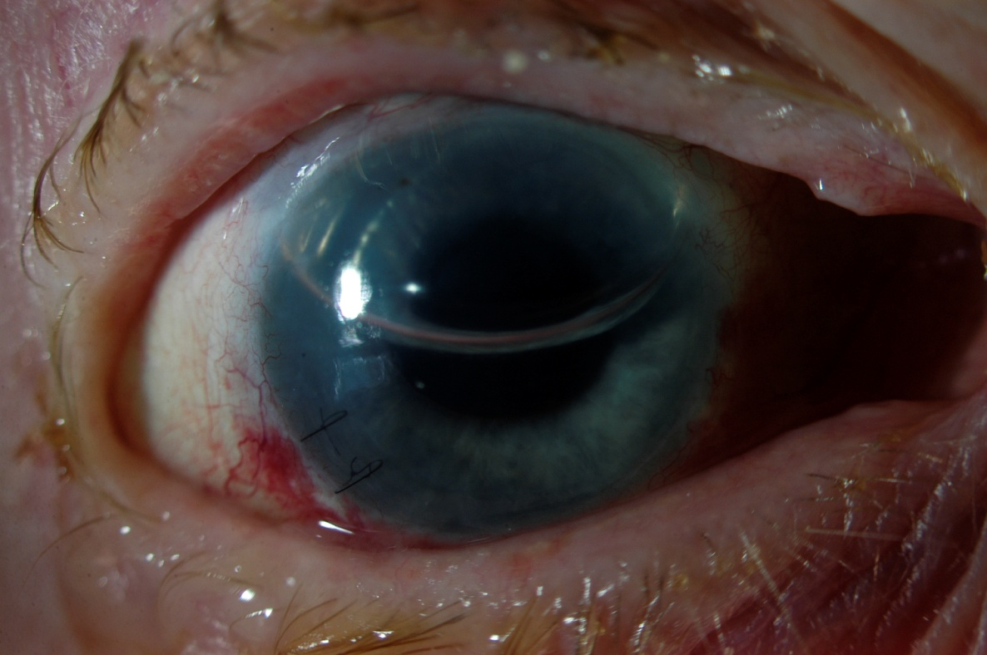
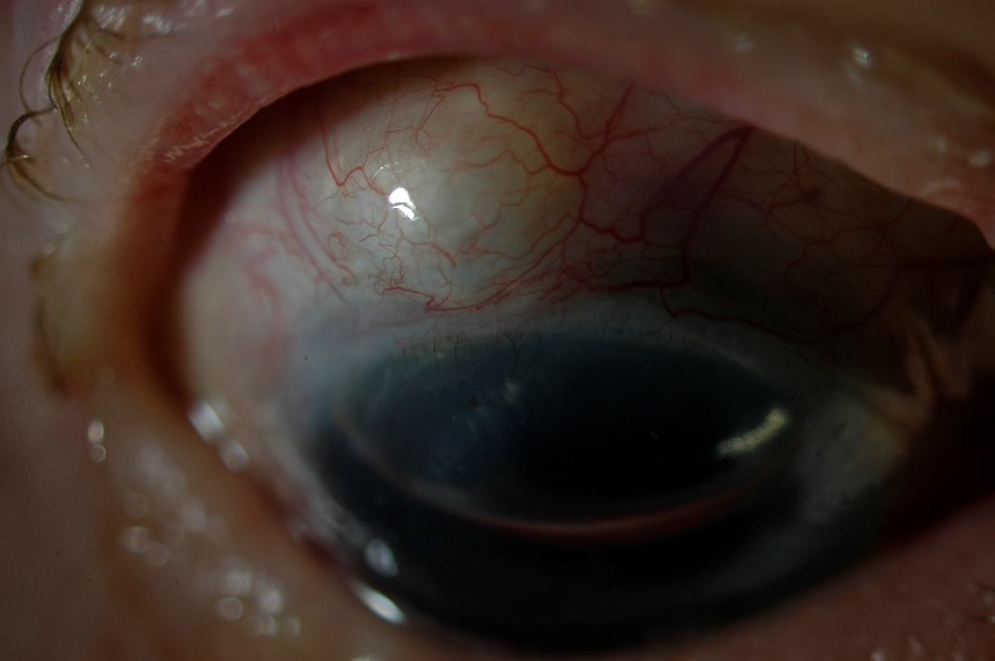
POD #1 showing 45% air fill in patient with prior Trabeculectomy
POD #1 showing air diffusion into filtering bleb

Slide 9
Endothelial Cell Count
Average cell count Tube patients = 2010 (range 1448-2532)
Average cell count for all patients = 1883 cells/mm³ (range 578-2687, n=48)
*Two patients in Tube (1 and 2) group lost to follow up

Slide 10
Endothelial Cell Count
Average cell count Trab patients = 1685.6 (range 872-2087)
Average cell count for all patients = 1883 cells/mm³ (range 578-2687, n=48)
*Two patients in Trabeculectomy (6 and 7) group had poor cell count capture

Slide 11
Summary
Post-Operative Air fill
  There were no cases with air found in any of the Tube shunts
  There was two cases of air found in the Trabeculectomy filtering blebs on post-op day 1
  Air fill percentages ranged from 0 to 45% with an average of 24%.
Endothelial Cell counts
  Did not differ from average endothelial cell counts collected in patients at the same center without prior glaucoma surgery (Average =1883 cells/mm³, range 578-2687 cells/mm^{3,} n=48)
Graft dislocation:
  One of the eleven patients (9%) had a dislocated graft requiring a refloat, this compares to overall value dislocation rate of 6/48 (12.5%) of all patients undergoing DSEK. All dislocations underwent successful refloating with reattachment
Graft Failure
  One patient in the Trabeculectomy group (patient 7) had a primary graft failure requiring full thickness PK
Intraocular Pressure
  Two patients in the Trabeculectomy group (patient 4 and 6) required paracentesis venting on post operative day one for increased intraocular pressure
  One patient required a diode laser to reduce longstanding intraocular pressure-this was believed to be unrelated to the DSAEK procedure
  No patients required additional glaucoma medical therapy as a result of undergoing surgery

Slide 12
Conclusions
In our case series, sustained increases in intraocular pressure were not found in these patients, there were however two patients with short term intraocular pressure elevations.
None of these eleven patients needed additional Glaucoma surgery or additional medications to lower intraocular pressure in the immediate postoperative period.
The majority of our patients had improvements in visual acuity. Graft dislocation also did not appear to be higher in our series.
Further investigations, in particular with greater sample size, are needed to study the long-term outcome of this procedure in this patient subset.

